Slide 1
Behavioral Treatment of Chronic Pain
Will Hamilton, PhD
AYC; July 2018

Slide 2
History of Behavior Therapy
1st Wave- 1940’s on- Classic and operant conditioning, stimulus control, extinction, etc Skinner and Pavlov
2nd Wave- late 1960’s on- clinical applications of The Cognitive Revolution; cognitive restructuring, cognitive distortions, journaling, goal setting; Beck and Ellis
3rd Wave- 1990s on- research driven, often driven by context and understanding language. Emphasizes acceptance, mindfulness, compassion. Treatments like ACT, DBT, MBCT, FAP, CFT and people like Hayes and Linehan.

Slide 3
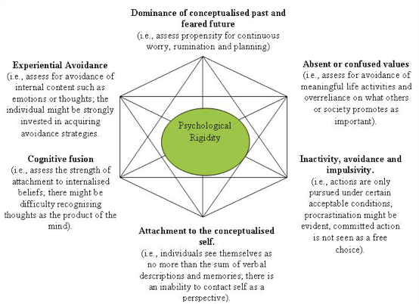

Slide 4
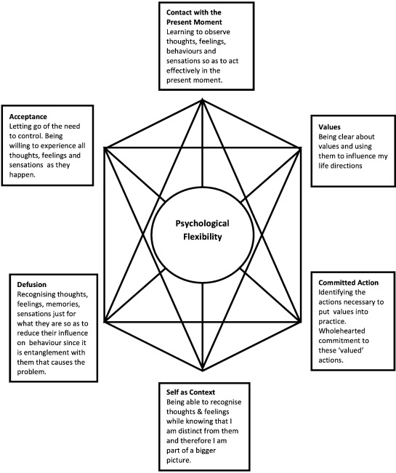
ACT Hexaflex

Slide 5
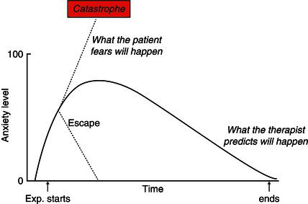
Chronic Pain- Unwillingness vs. Acceptance
Experiential Avoidance:
Pain Phobia- Avoid pain at all costs
“I can’t do that”
“If I don’t take pain medication, I can’t function”
Developing Willingness:
Exposure and Response Prevention*- ex soccer practice
The medicalization of discomfort leads to fragility- consider fasting, exercise, cold exposure (open vs bracing)
Psychoeducation about reconditioning; quicksand metaphor
Expanding and Contracting around the pain- the unwelcome houseguest

Slide 6
Chronic Pain- Cognitive Fusion vs. Defusion
Cognitive Fusion- Trouble distinguishing thoughts as objects/expressions of mind, rather than the Self; most verbal rules about pain
“I can’t do that” “I’ve tried everything, There’s no point in trying” “That won’t work for me”
Cognitive Defusion- Creating sense of space around thoughts
Writing letter to pain, taking pain out for tea, blues songs, hand-face distance
Tug of War, chinese finger traps, drawing body maps of pain
“Just noticing what your mind says about that- thanks again Mr. Pain!”
Subtle reframing about what exposure to discomfort is- e.g. compassion, courage, oppurtunity to learn

Slide 7
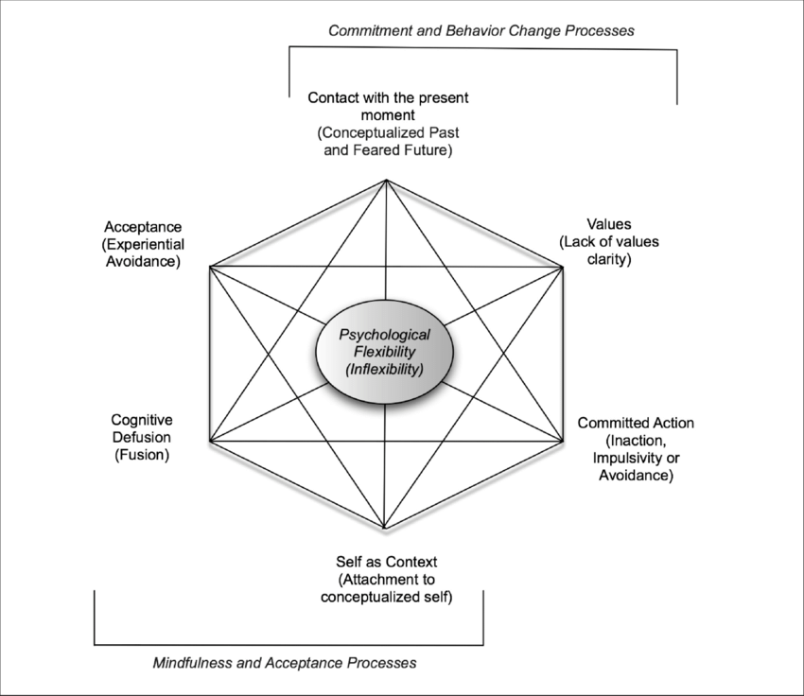

Slide 8
Chronic Pain- Conceptualized Past & Future vs. Mindfulness
Low Contact with Present Moment- Either excessive fixation on past (and how much has been lost) or future (fears of how it will get worse); unawareness- “Body is just down there”
High Contact with Present Moment/Mindfulness-
“Can we learn to be with this, as it is, without changing it?” “I am noticing”
Body Scan/ Mindful Movement; formal MBSR practice
Brief somatic awareness practice

Slide 9
Chronic Pain- Conceptualized Self vs. Self as Context
Conceptualized Self- Rigid, narrow view of self, often dominated by Pain- “Pain Patient” regardless of context. Interactions often dominated about pain- MD visits, etc
Self As Context- More flexible view of the self, that may also include pain.
Sky-like mind exercise; Chessboard metaphor; Self at different ages, Parts work
Perspective taking exercise- what would compassionate other say to you
Support/Treatment Groups can be helpful for shifting isolated identity to common humanity- will get cohort effects in group yoga practice (“everyone here has something in common”

Slide 11
Chronic Pain- Unclear Values vs. Values Clarity
Unclear Values - “The only thing that matters is getting out of pain”
Clear Values-
Ice Bucket Tolerance Example
“What would you do with just one pain free day?”
“What is more important than discomfort?”
Great Wall Story; Compass Metaphor; Antidote from Mad Scientist metaphor
Groundhog day

Slide 12
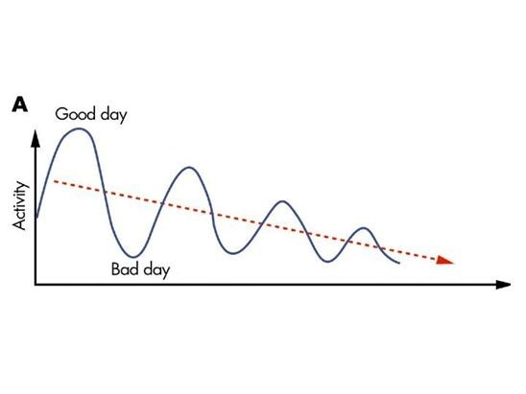
Chronic Pain- Inaction/Impulsivity vs. Committed Action
Poor Commitment- often looks like crash and burn cycle or chronic kinesiophobia (fear of movement due to anticipating pain)
As well as difficulty with goal setting

Slide 13
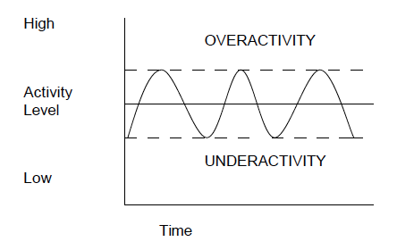
Chronic Pain- Inaction/Impulsivity vs. Committed Action
Committed Action- Literally, the entire canon of behavioral therapy that focused on the how and what of change.
Ex: Pacing
Time Based vs. Activity Based
Planning
Prioritizing

Slide 14
Chronic Pain Committed Action (cont)
SMART goals, BJ Fogg/minimum effective change goals- jumping off paper ex; Motivational Interviewing (e.g. ready, willing, able)
Homework completion/ symptom charting/behavioral experiments/compassion or classic thought records/Behavioral Activation*, pleasant activity scheduling
Mindfulness/Psychophysiology regulation (imagery, progressive muscle relaxation, self-hypnosis, paced breathing), massed vs spaced practice; environmental cueing
Assertiveness training/ Anger deescalation plans/Expanding social support, formal coping strategies (i.e. DBT Distress Tolerance and Emotion Regulation), decreasing pain behavior
Attempting diet or exercise change, sleep hygiene, taking meds/supplements, contacting providers
Crisis/WRAP Plan/written and rehearsed; deciding where medications fit in this

Slide 15
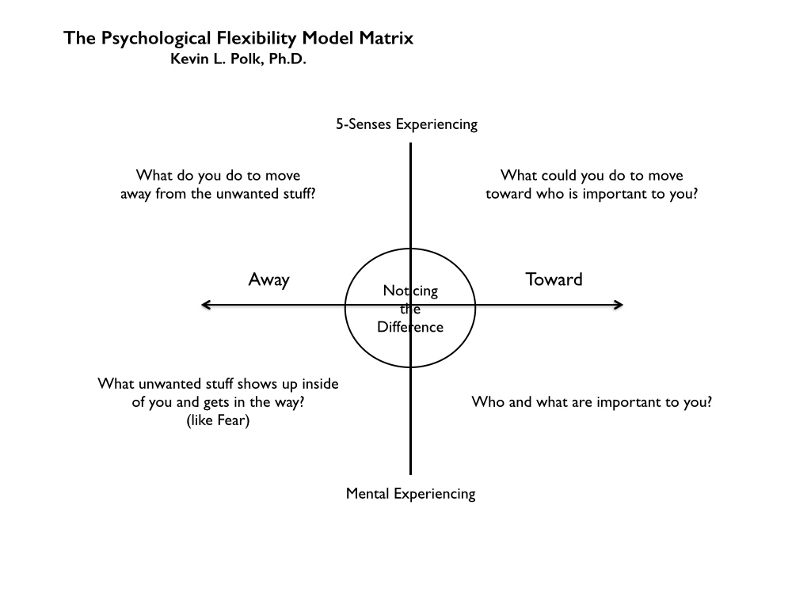

Slide 16
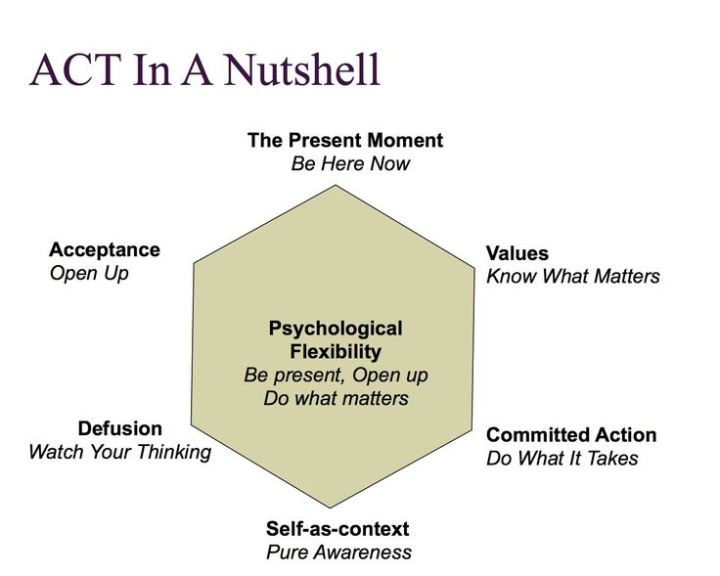
ACT Informed Yoga Teaching

