Slide 1
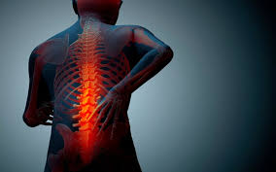
Chronic Pain 101
Will Hamilton, PhD
AYC; March 2019

Slide 2
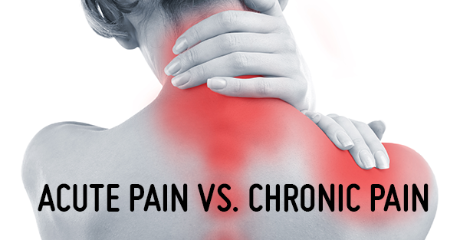
Examples
Cuts
Burns
Fractures
Child Birth
Surgery Recovery
Occasional Headaches
Etc
Sciatica
Low Back Pain
Chronic Knee Pain
Fibromyalgia
Neuropathies
IBS
Arthritis
Bursitis
Frequent Migraines/Headaches (+8-15/mo)
Etc

Slide 3
Duration
Acute
< 3 months
Chronic
> 3 months
Updated from 6 months

Slide 4
Prevalence
Acute
100%, part of life*
Chronic
15-30% of population in year; 50-100 million in US
17.6% of population has severe chronic pain¹
CDC- 11% of population disabled from significant life role by pain

Slide 5
Function
Acute
Warns of tissue damage
‘Do not use that- it is injured’
Chronic
Pathological Process
Tissue is deconditioned
NS is dysregulated
Prioritize Self-Care
Increase understanding of limits
‘Use it more, wisely’

Slide 6
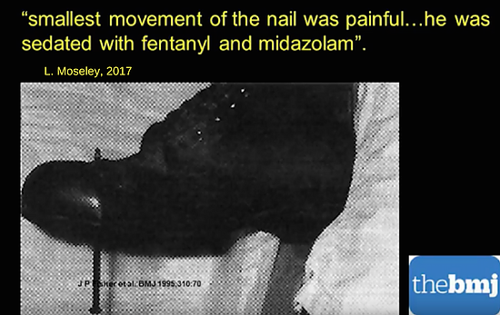
Challenging the Mind-Body Divide

Slide 7
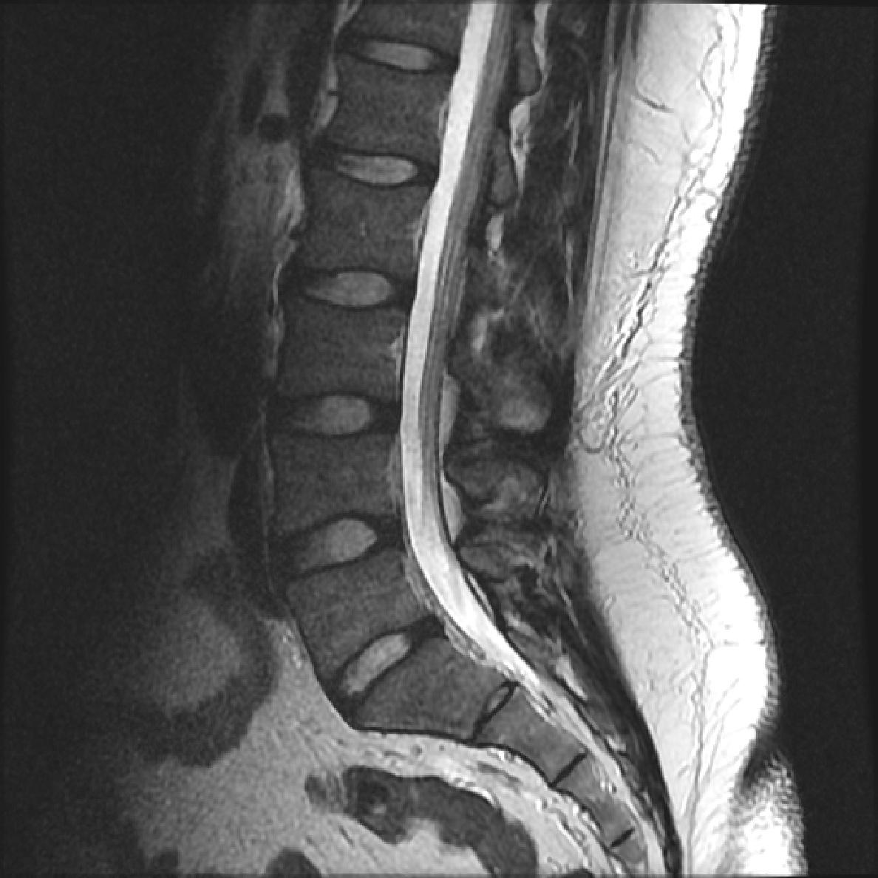
Treatment Course
Acute
Generally Clear Diagnosis,
Treatment, and Prognosis
Medications often helpful
Ex. Opiates great for suppressing suffering for weeks
Early medications helpful for preventing chronic pain
Chronic
Frequently Unclear Diagnosis, Treatment, and Prognosis; often exclusionary/”trash-can” Dxs;
Ex. MRIs show evidence of disc bulge in 39% of asymptomatic 20 year olds, and 96% of asymptomatic 80 year olds²
Medications can be helpful, but are more complex;
Iatrogenesis/Opiate-induced hyperalgesia common
Russian Injury story

Slide 8
Anticipated Patient Role/Means of Recovery
Acute
Passive- Patient as Machine
Rest and Time
Chronic
Must become active, well-informed;
Patient as Garden
Adequate balance of rest and activity, with exposure-response prevention to movement

Slide 9

Social Support
Acute
The conditions are often visible.
Social scripts are relatively easy
(e.g. what do you say to someone wearing a cast)
Social support often increases
Time-limited, most people can have resilience
Chronic
The conditions are often invisible
Social scripts are relatively complex
(e.g. what do you say to someone who has cancelled plans, again).
Social support is variable; Isolation is common; peripheral support dwindles; proximal support increases, may be in coregulation with patient

Slide 10
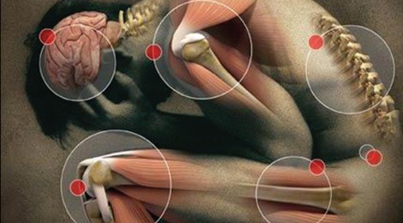
Mental Health
Acute
Mental Health concerns are often minimal. Course is time-limited, and most most people have a degree of resilience
Chronic
Increasingly central to pain management/perception
4x greater rate of depression and anxiety³
Migraine comorbid with generalized anxiety (x3.5-5.3), panic disorder (x3.7), and bipolar disorder (x2.9-7.3)⁴
75% patients with depression report pain to primary care⁴
Part of deconditioning loop; Pain phobia can play central role; pre-existing MH increase vulnerability to CP developing

Slide 11
Mental Health- Causality

Slide 12
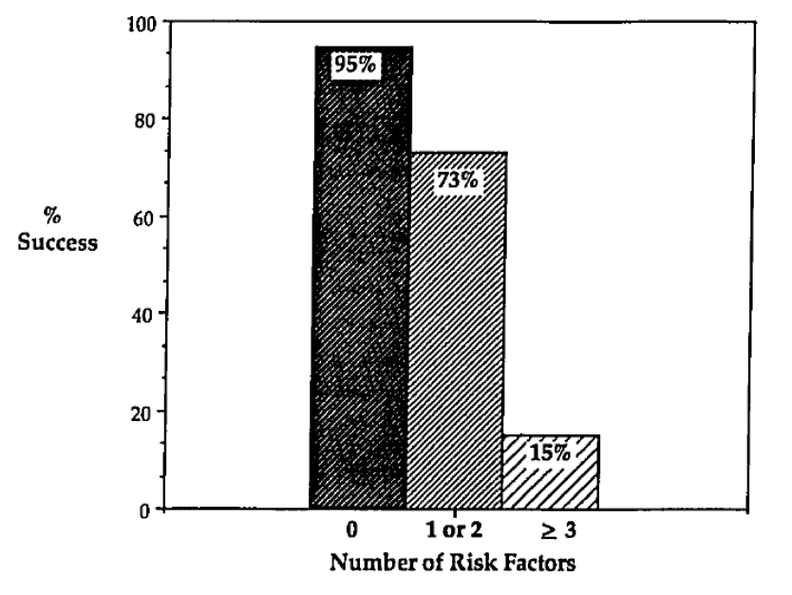
Mental Health- Causality
Schofferman (1992)⁵ (n=86)
Five Adverse Childhood Experiences (ACEs) included in patient questionnaire prior to lumbar surgery
Patients who had 3+ ACEs had 85% likelihood of an unsuccessful surgical outcome
If poor surgical outcome, the incidence of these traumas was 75%.
In the group of 19 patients with no risk factors, there was only a 5% incidence of failure.

Slide 13
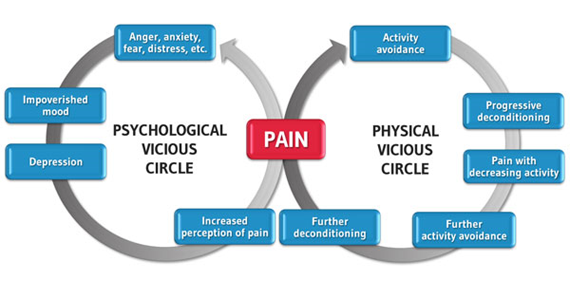
Mental Health- Causality
Chronic widespread pain is an indicator of central sensitization
Altered levels of a stress hormone prospectively predicted the development of chronic widespread pain⁶
Patients with histories of trauma tend to have lower pain thresholds⁷

Slide 14
Integrative Pain Treatment- Four Buckets
Reconditioning
Internal/Stress Management
External/Manipulative
Biochemical

Slide 15

Reconditioning
Physical Therapy: Especially ones that emphasize active techniques, with patient-specific interventions.
Feldenkrais: A small study suggested that improving body awareness and movement efficiency can produce significant improvements in pain severity and depression, compared to standard physiotherapy.
Tai Chi: Can help provide immediate relief for osteoarthritis, osteoporosis, and low back pain.
Exercise/Structured Fitness Classes: If one has more mild levels of pain, non-specific fitness classes and strengthening/lengthening programs can be helpful for certain pain conditions.
Walking, swimming, low-impact free weights...

Slide 16
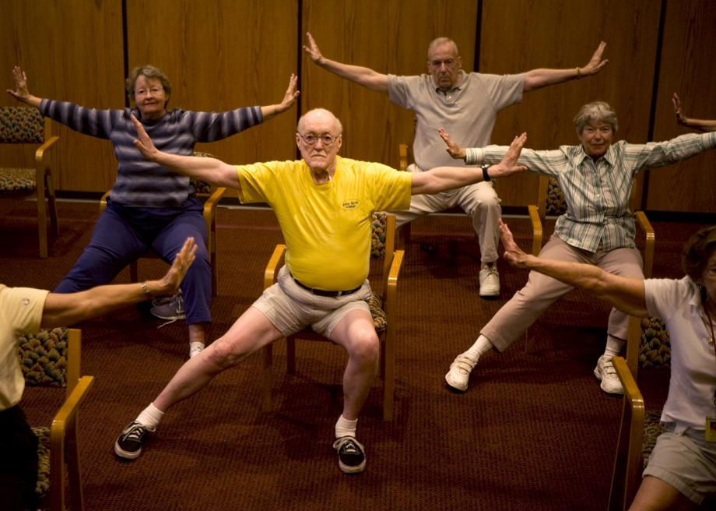

Reconditioning-
Yoga
One randomized control trial found that individuals with low back pain assigned to a Iyengar yoga therapy class had significantly improved scores on measures of functional disability, pain intensity, and depression when compared to standard medical treatment at 24 weeks and at 48 weeks¹⁰
Another Iyengar yoga study found a 16 week course significant reductions in pain intensity (64%), functional disability (77%) and pain medication usage (88%) in the yoga group at the post and 3-month follow-up⁸
Another study found yoga program reduced low back pain more significantly than a standard exercise routine after 12 weeks ⁹

Slide 17

Reconditioning-
Yoga
Another Large RCT (n=228) compared 12-week Viniyoga program (5-11 postures, ~50 min practice, weekly) to a self-care book or traditional stretching (~15 exercises, ~50 min practice, weekly ^{(9a/b)}
Viniyoga was superior to self-care book for reduction on measures of Disability (~9 → ~4.5) and Bothersomeness of Pain, sustained at 26 weeks. Traditional
Traditional stretching had comparable results

Slide 18
Internal/Stress Management
Cognitive-Behavioral Therapy: Research has found that severity of psychological distress is more predictive of pain severity than physical indicators (e.g. disc protrusion, etc). Decreasing pain phobia and increasing behavioral activation are central components of treatment. Classic CBT and Acceptance/mindfulness based BT have similar effect size (~.35-.55) on different measures such as: acceptance, pain catastrophizing, social role participation, quality of life, depression, analgesic use. Pain severity less impacted, or reductions occur later.^{11,12,13}
Emotional Awareness/Mind-Body Interventions: Stress is a central component of pain severity, and managing these stressors can be remarkably helpful for improving pain sensation.
Mindfulness/Compassion: Over 100 randomized clinical trials have shown that mindfulness training (such as Mindfulness Based Stress Reduction courses) improve a variety of medical conditions, including reducing the perception of pain severity by 30-50%. Similar effect size to CBT.^{14,15}
Hypnosis: A 2003 study found that hypno-analgesia can significantly improve : ratings of pain, need for analgesics or sedation, nausea and vomiting, and length of stay in hospitals
Biofeedback/Neurofeedback: One study of CRPS found NFB helpful for reducing pain severity by one SD¹⁶

Slide 19
External/Manipulative
Non-thrust manual (Non-HVLA) therapy: e.g. muscle energy techniques, strain-counter strain, myofascial release, spine mobilization, and cranio-sacral therapy.
Massage: A Cochrane review states that massage produces similar improvement in back function and pain as exercise and better short-term outcomes compared to mobilization, relaxation therapy, physical therapy, acupuncture and self-care education.
Acupuncture: Often can be more effective that standard medical treatments for conditions such as headaches/ migraines and neck/low back/knee pain. Also has significant properties of relaxation and motivational health coaching
Assistive Devices/Techniques: such as TENS/Quell/Cefaly; infrared sauna, cryotherapy, contrast therapy etc
Note regarding Chiropractic/Osteopath- High velocity, low amplitude (HVLA) interventions:
Patients with low back pain are most likely to respond to manipulation if they have pain for less than 16 days, symptoms that do not radiate past the knee, and low fear-avoidance.

Slide 20
Biochemical
Anti-Inflammatory Diet: The degree of low-grade inflammation in one’s body can strongly influence the severity of pain chemicals the body produces (such as Substance P). Reducing high-glycemic foods (sugars and starches) and excessive adipose tissues, and eating more balanced diet (mostly plants) can reduce pain severity. Further, limiting specific triggers can be especially helpful for certain conditions such as migraines or IBS, or conditions associated with excess gut permeability.
Sleep Quality: Impaired sleep efficiency has a strong interrelation with pain severity. Using sleep hygiene and stimulus control for sleep can help pain severity.
Medications: Pharmaceuticals are an important, albeit not solo, form of treatment to effective pain management. Opiates should be used with great caution to prevent sensitization/rebound, and other agents such as NSAIDS, antidepressants, NMDA/GABA agents, anticonvulsants, cannabinoids, and herbal formulae should be discussed with a prescriber.

Slide 21
Citations
8- Kimberly Anne Williams et al 2005 Effect of Iyengar yoga therapy for chronic low back pain
9 20 DECEMBER 2005 Comparing Yoga, Exercise, and a Self-Care Book for Chronic Low Back Pain: A Randomized, Controlled Trial Karen J. Sherman, PhD, MPH; Daniel C. Cherkin, PhD; Janet Erro, RN, MN, PNP; Diana L. Miglioretti, PhD; Richard A. Deyo, MD, MPH
9a.b. Sherman, KJ, Cherkin, DC, Erro, J, Miglioretti, DL, Deyo, RA. (2005).Comparing yoga, exercise and a self-care book for chronic low back pain: A randomized, controlled trial. Annals of Internal Medicine, 143:849-856.
Sherman, K., Cherkin, D., etal (2011) A Randomized Trial Comparing Yoga, Stretching, and a Self-care Book for Chronic Low Back Pain. Archives of Internal Medicine. Published online October 24, 2011. doi:10.1001/archinternmed.2011.524
10 PAIN® Volume 152, Issue 3, March 2011, Pages 533-542 PAIN® Acceptance-based interventions for the treatment of chronic pain: A systematic review and meta-analysis
11 https://www.ncbi.nlm.nih.gov/pubmed/274796412
12 https://www.ncbi.nlm.nih.gov/pmc/articles/PMC3584580/
13 http://www.bandolier.org.uk/booth/alternat/AT122.html
14https://academic.oup.com/painmedicine/article/16/4/641/2460516
15 https://academic.oup.com/painmedicine/article-pdf/14/2/230/5165959/14-2-230.pdf
16http://michiganbraincoretherapy.com/storage/Chronic%20Pain/NEUROFEEDBACKTREATMENTFORPAIN.pdf
1 National Institutes of Health, American Chronic Pain Association, Mayo Clinic 2 Systematic Literature Review of Imaging Features of Spinal Degeneration in Asymptomatic Populations W. Brinjikji,AJNR Am J Neuroradiol. 2015 Apr; 36(4): 811–816.Published online 2014 Nov 27
3 The epidemiology of pain in depression.Lépine JP, Briley M Hum Psychopharmacol. 2004 Oct; 19 Suppl 1():S3-7.
4 Hamelsky SW, Lipton RB. Psychiatric comorbidity of migraine. Headache.2006;46:1327–1333.
5 Schofferman (1992) Childhood Psychological Trauma Correlates with Unsuccessful Lumbar Spine SurgeryArticle in Spine 17(6 Suppl):S138-44 · July 1992
6 19. McBeth, J., Silman, A. J., Gupta, A., Chiu, Y. H., Morriss, R., Dickens, C., King, Y., & Macfarlane, G. J. (2007). Moderation of psychosocial risk factors through dysfunction of the hypothalamic-pituitary-adrenal stress axis in the onset of chronic widespread musculoskeletal pain: Findings of a population-based prospective cohort study. Arthritis & Rheumatism, 56, 360-371.
7. Scarinci, I. C., McDonald-Haile, J., Bradley, L. A., & Richter, J. E. (1994). Altered pain perception and psychosocial features among women with gastrointestinal disorders and history of abuse: A preliminary study. The American Journal of Medicine, 97, 108-118.

