Slide 1
Self Massage
Investigate yourself with curiosity
Use the practices as a mirror
Increase your understanding about your body and how it responds to sensation
Practice adjusting your technique and/or pressure according to how your body feels
You’re in charge of the experience
The techniques are useful only if you can be in the presence of the sensation AND relax
Always place the balls on soft, squishy, muscle parts of yourself, rather than bony prominences.

Slide 2
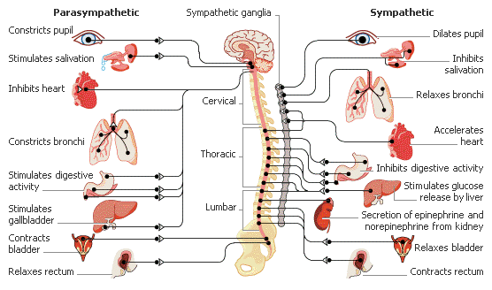
Autonomic Nervous System

Slide 3
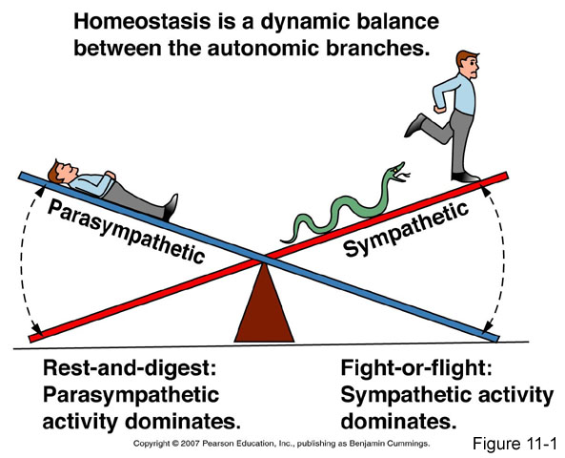
The great Seesaw
http://scienceknowledge.tumblr.com/post/143740819335

Slide 4
fascia
Fascia is a type of connective tissue that covers and interpenetrates every muscle, bone, nerve, artery and vein, and organ in the body in a continuous structure without interruption.
Fascia is a 3D web consisting of a watery extra cellular matrix (ground substance), elastin, and collagen fibers densely woven in all directions.
Fascia also plays a role in immune and endocrine function.
When we tug on fascia anywhere in the body, the tug spider webs throughout the system.
Physical trauma, emotional trauma, scarring, inflammation, or sustained postures can cause fascia to become dry and less pliable. It becomes tight, restricted, and can be a source of tension to the rest of the body.
Fascia is thought by some to be the location of embodied consciousness, the storage unit for life’s experiences and traumas and our resulting “holding patterns.”
Fascia requires movement to stay hydrated and pliable. Changing fascial length requires low loads sustained for a long time.

Slide 5
FAscia

Slide 6
Belly Breathing on Ball

Slide 7
Breathing at the wall

Slide 8
Come to elbows

Slide 9
Arm and Leg Reach

Slide 10
Alternate Leg Crawl

Slide 11
Shift side to side

Slide 12
Chest Breathing on Ball

Slide 13
Breathing into the upper back

Slide 14
Side Bending and Arm Movements

Slide 15
Lateral Chest Breathing

Slide 16
Explore the gluteal region – tension in this area is sometimes associated with low back/sacral pain and sciatica type symptoms. Place one ball near the top of each gluteal area. Melt into the balls with steady breathing, long exhales.

Slide 17
Consider moving the knees back and forth for “windshield wipers” – move slowly and in pace with your breath.

Slide 18
Explore shifting your hips side to side

Slide 19
Move the balls out to the sides a bit and continue to explore sensation there. Then move them down a bit and do the same.

Slide 20
Explore moving the knees away from each other and back with your breath

Slide 21
Place both balls at the lower back just above the pelvis.

Slide 22
Consider hugging one knee toward the chest and alternate with the pace of your breath.

Slide 23
Consider taking one knee out to the side and then across the body, maintaining your steady breath.

Slide 24
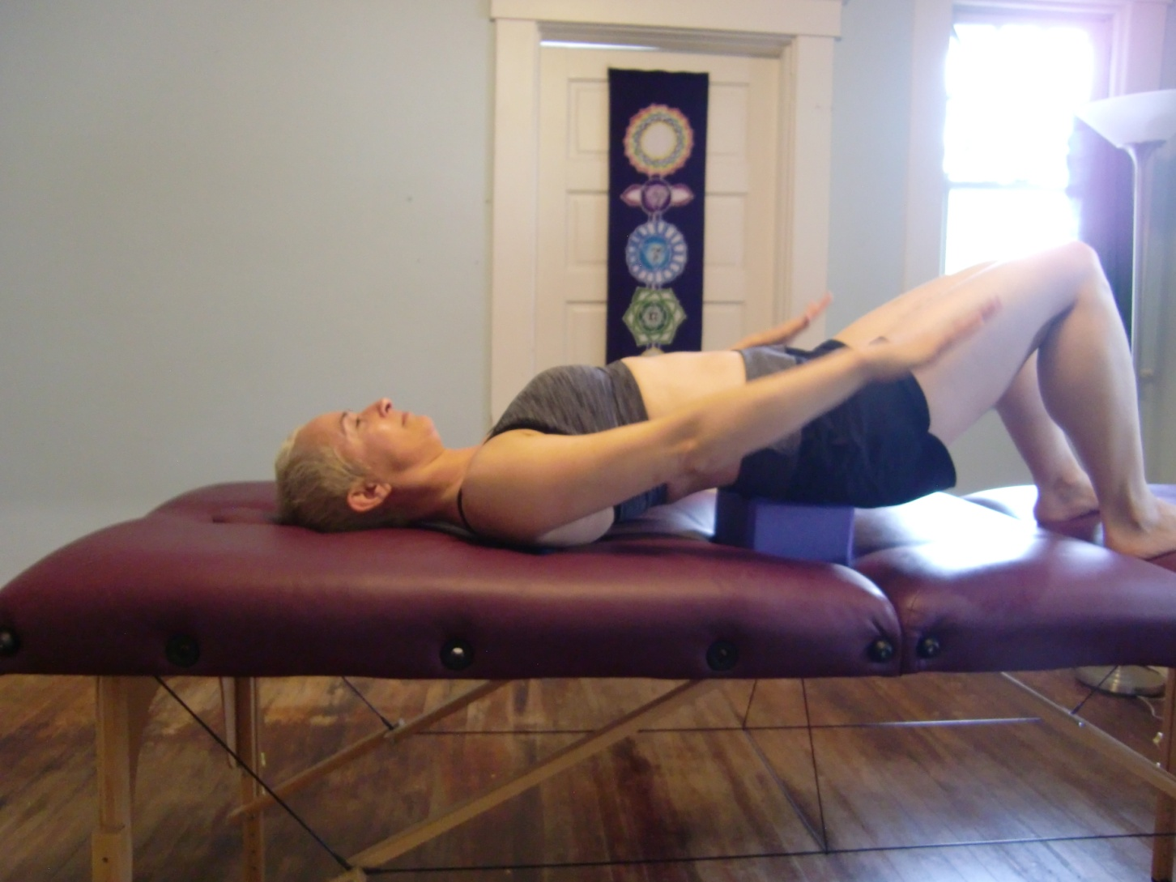
While in a supported bridge on a block, place the balls at the mid back, so that they straddle the spine. Explore arm movements with your breath. Inhale arms up, exhale arms down.

Slide 25
Explore arm movements with your breath. Inhale arms out, Exhale give yourself a hug

Slide 26
Move the balls along the spine and explore these movements at each stop, and/or simply melt into the balls with steady breathing along the way.

Slide 27
Explore the upper trapezius – an area often associated with headaches, neck and shoulder pain. Still in your supported bridge on a block, drape upper traps over balls, then explore arm movements with your breath, slow and steady (up/down, and out to sides/hug)

Slide 28
Move the block from the sacrum up to the head to explore the suboccipital area – tension in this area is commonly implicated in headaches. Place balls at the very top of the neck at the base of the skull. Anchor the balls on a block or a blanket. steady breathing, long exhales.

Slide 29
Gentle nodding and rotation

Slide 30
Roll gently to the side just at the base of the skull

Slide 31
Gentle rotation and nodding

